Slide 1
Matrix Factorization

Slide 2
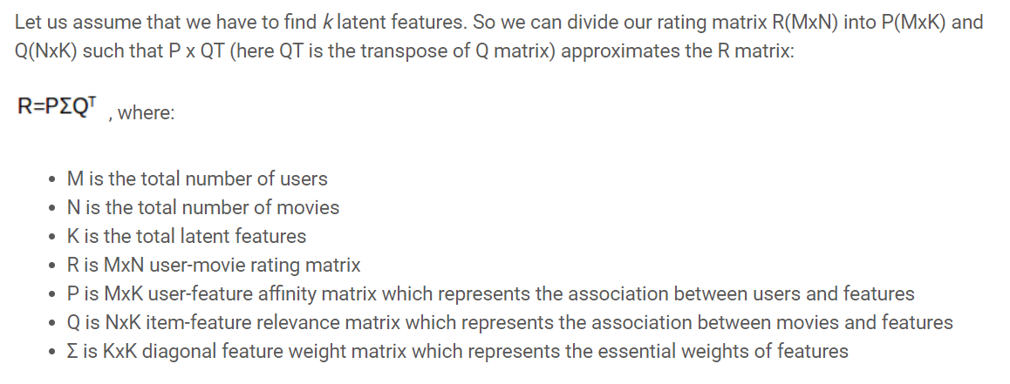
What is Matrix Factorization
S
X
L

Slide 3
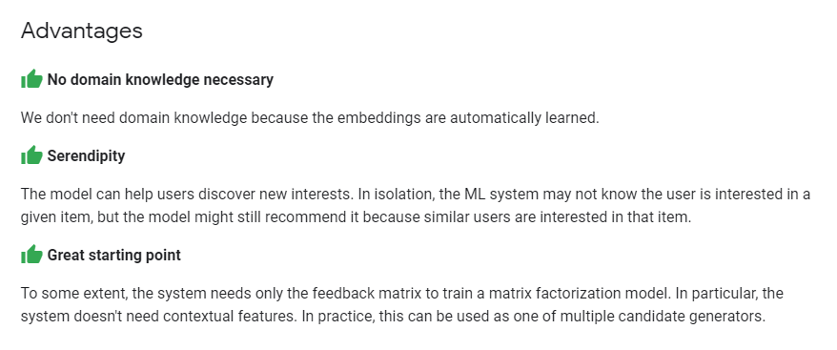
Why Matrix Factorization

Slide 4
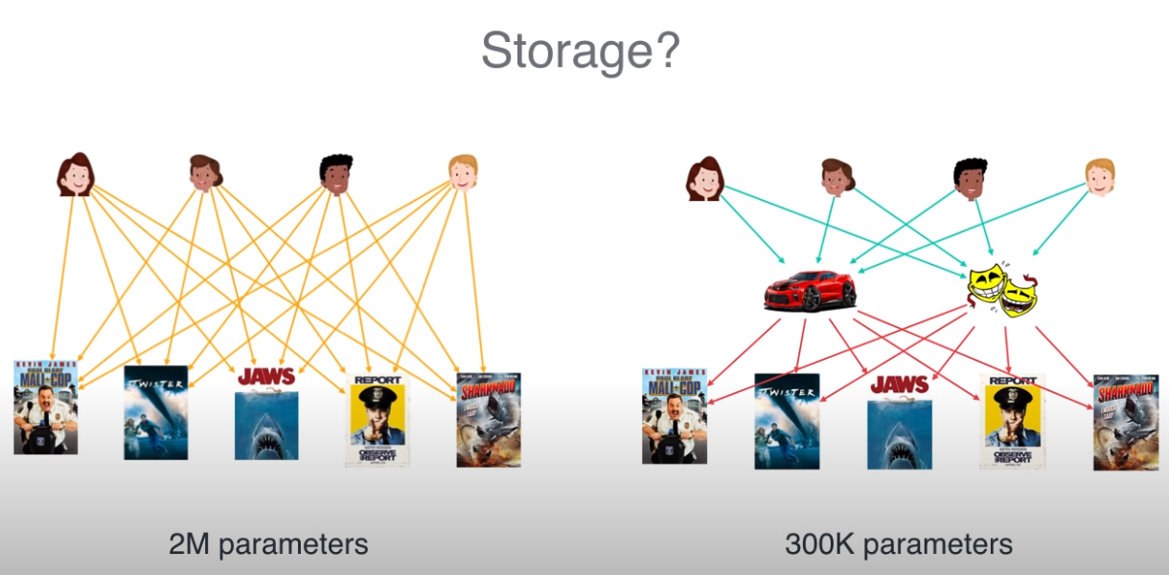
Why Matrix Factorization

Slide 5
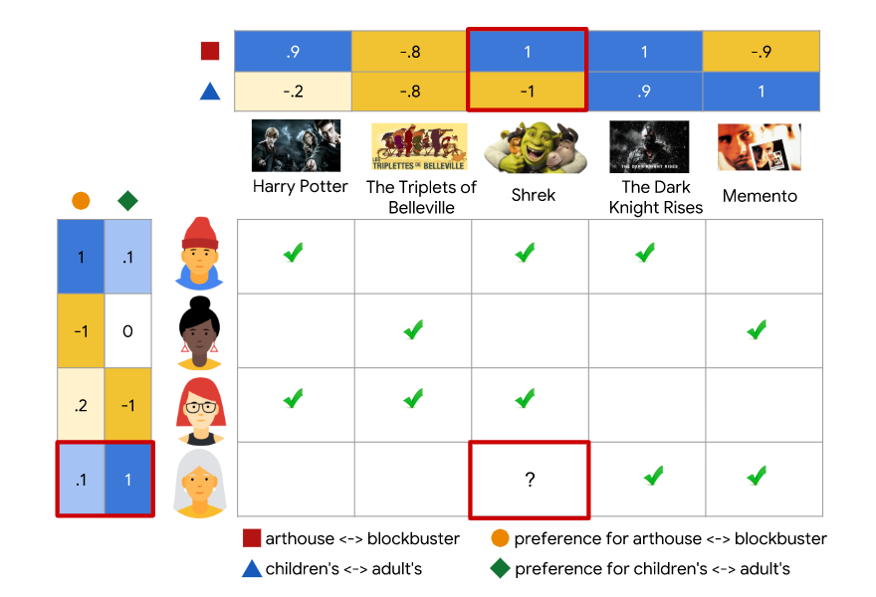
How to do Matrix Factorization

Slide 6
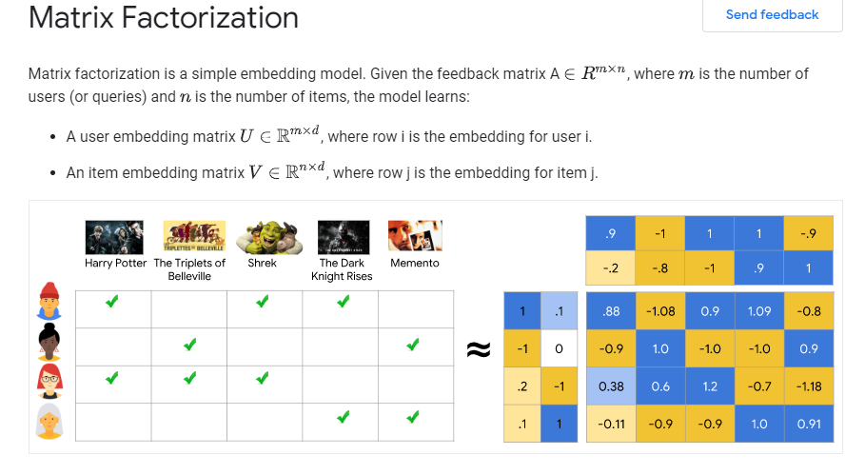
How to do Matrix Factorization

